Slide 1
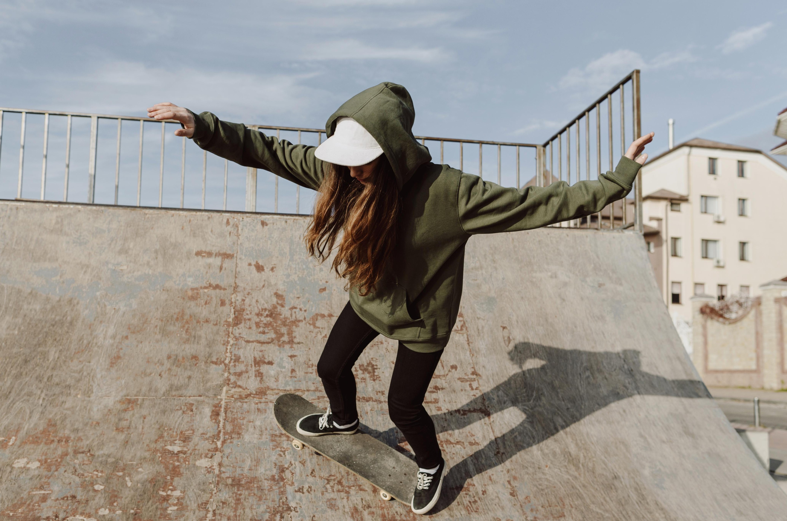




Slide 2
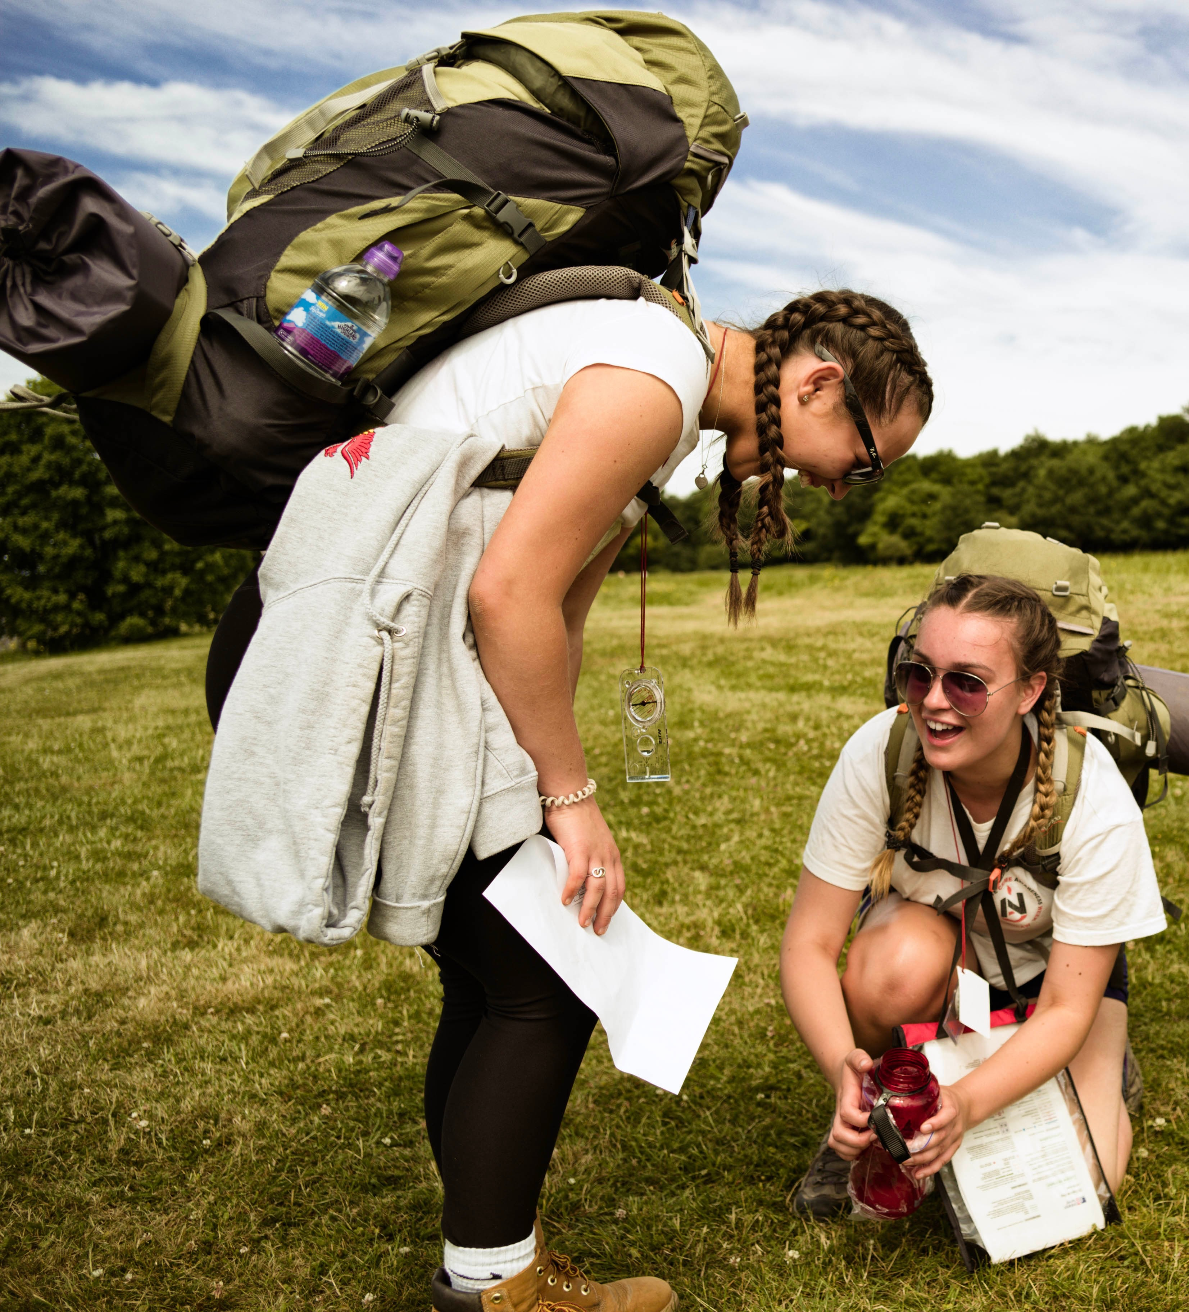

What is the DofE?
A qualification you can do in your own time
You choose your sections, so you are in charge of what you do
It is a fantastic opportunity – but you must be organised and committed in order to suceed!

Slide 3
So what is the DofE…
Your DofE programme is a real adventure.
It doesn’t matter who you are or where you’re from.
You just need to be aged between 14* and 24.
*you can start in the school year you turn 14, i.e. S3
You can do DofE programmes at three levels:
Bronze (aged 14+)
Silver (aged 15+)
Gold (aged 16+)
…which lead to a Duke of Edinburgh's Award.

Slide 4
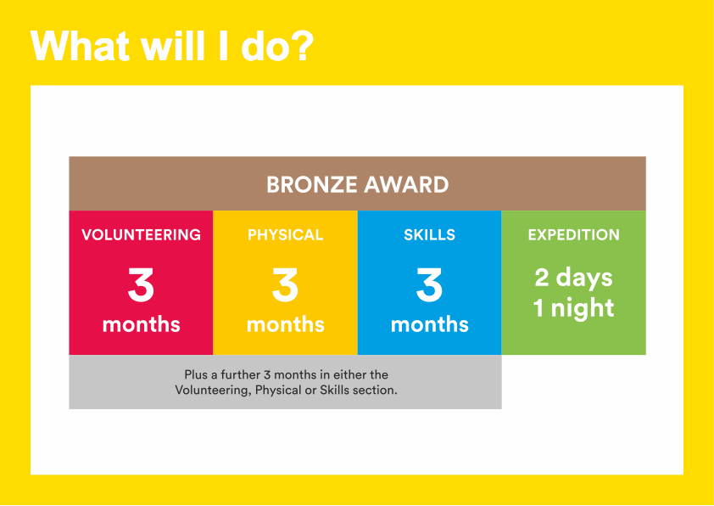
Notes:
To achieve your DofE Bronze Award, you will need to complete four sections – Volunteering, Physical activity, developing a skill and the Expedition.​
Activities for each section take a minimum of one hour a week, so they can easily fit in around your studies and other interests.​
You will need to spend at least 3 months completing each of the Volunteering, Physical and Skills sections.
You will also need to decide which one of these you would like to do for six months.​
You will need to keep a record of the time you spend on each activity.
You should ask somebody who has a good understanding of the activity you have chosen to write a report describing what you have done.​
It may seem daunting at first but remember that most activities can count towards your DofE.
I will now describe each section of the award in more detail.

Slide 5
How do I do it?
You will have to identify and organize your own:
Volunteering
Physical
Skill
Then you will need to upload evidence of what you have been doing on eDofE. This can be photos or text.
When you have finished (after 3 or 6 months) your Assessor will have to write an Assessor’s Report. They can do this either online (www.dofe.org/assessor) or fill in the form you will receive in your Welcome Pack

Slide 6

Volunteering section
Take action and make a difference to the causes you care about
Help others and change things for the better
Notes:
As part of your Bronze DofE Award, you will need to donate some of your time to volunteering.​
Volunteering is a chance to help other people, and to make a difference to the causes you feel most passionate about.​
As well as changing things for the better, lots of young people find that volunteering is a great way to increase their confidence and gain new skills.​
Examples of volunteering could be coaching a local football team, collecting items for a foodbank or campaigning for change on issues you feel passionate about
Presenter: Feel free to include a broad range of examples here and to talk about what previous participants have done.
You can choose to volunteer in any area you would like – the only rule is that you must not be doing a job that companies would normally pay somebody for.​

Slide 7
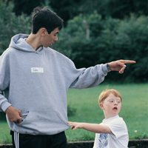
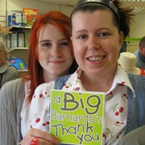
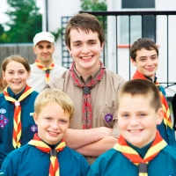
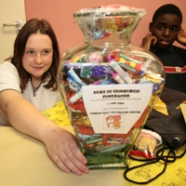
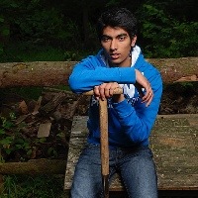
Volunteering categories
Helping people
Community action and raising awareness
Coaching, teaching and leadership
Working with the environment or animals
Helping a charity or community organisation
Who can assess me? e.g Key Adult, Scout leader, Charity shop manager
How much do I need to do? 1hr per week minimum
Notes:
Explain why we have chosen these activities – flexible enough that all volunteering activities should fit in. Old categories were very prescriptive. Make it clear that some activities will fit into more than one category, this doesn’t matter and will often depend on the aim of the young person.
This is outlined on pages 41 – 42 on the DofE Handbook.
Give example on page 42 of Handbook about how First Aid training could be 3 months as a Bronze Skill for one person or training for 3 months and 9 months practical volunteering with St John Ambulance as a Gold Volunteering activity for another.
You could use any example here:
A Bronze DofE group attends a police course once a week to learn about the criminal justice system. As part of the course, the group are asked to design a project to raise awareness about personal safety in their community. A Gold DofE programme participant supervises the group and the police officer is the Assessor. The group deliver a number of assemblies to their peers as well as at the local primary school on how to stay safe.

Slide 8



Volunteering
Litter picking in your local area- take photos and videos and get your Key Adult to be your assessor
Helping a neighbour with their garden
Helping in the school garden
Coaching a younger team at your Football training
Working in a bike shop for free (learning how to fix a bike would be the skills section)
Working for any business that makes money
You can find volunteering opportunities on the Team

Slide 9
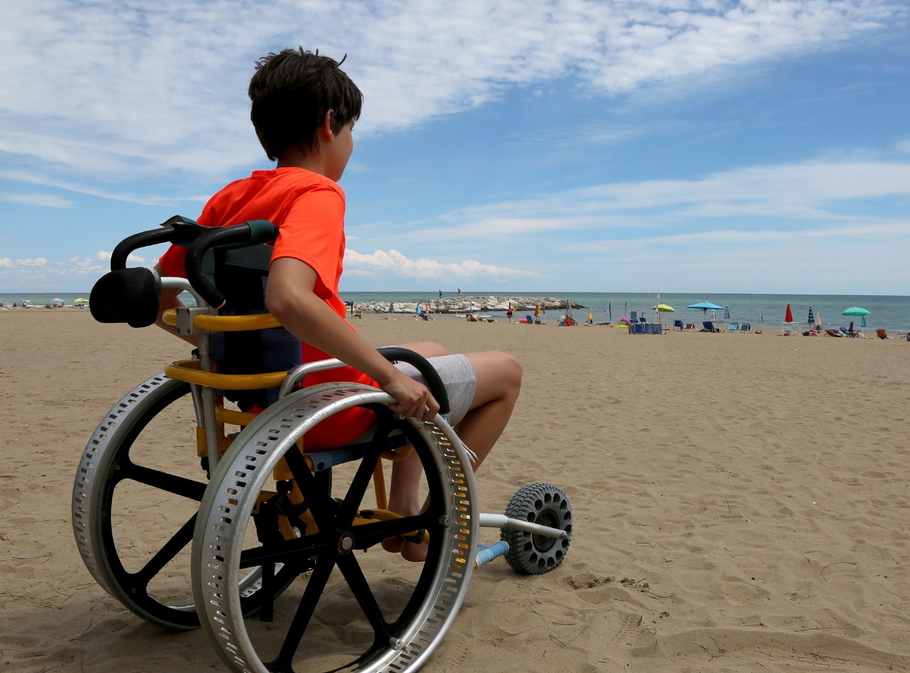

Physical section
Take part in whatever
dance, sport or ﬁtness
activity you would like
Get ﬁtter and have fun
along the way!
Notes:
To complete the Physical section of your Bronze Award, you will have the opportunity to take part in regular physical activity.
Becoming more active can be a huge amount of fun, and it can also help you feel happier and healthier.
Almost any dance, sport or fitness activity can count — it’s completely up to you which activities you choose.
You may decide to join a team or to do something on your own.
You may like to try something completely different, or to concentrate and improve on an activity you already do.
​

Slide 10
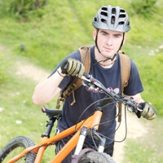
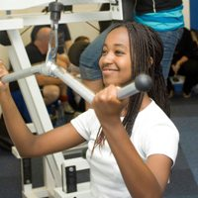
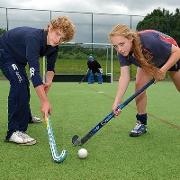
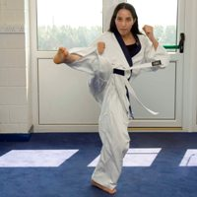
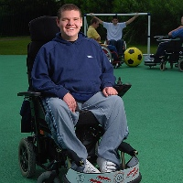
Physical categories
Team sports
Individual sports
Water sports
Racquet sports
Dance
Fitness
Extreme sports
Martial arts
Who can assess me? e.g PE Teacher, Coach, Friend of the family (who ideally has some knowledge of the sport)
How much do I need to do? 1hr per week minimum

Slide 11
Physical
Running
Cycling
Netball club
Dance
Diving
PE lessons- it has to be something you do outside of school

Slide 12
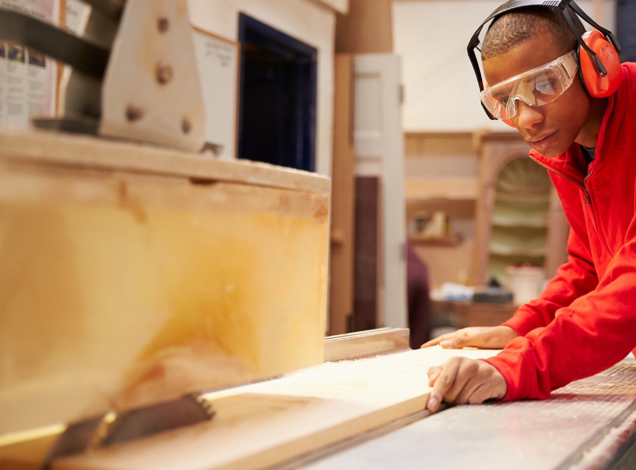
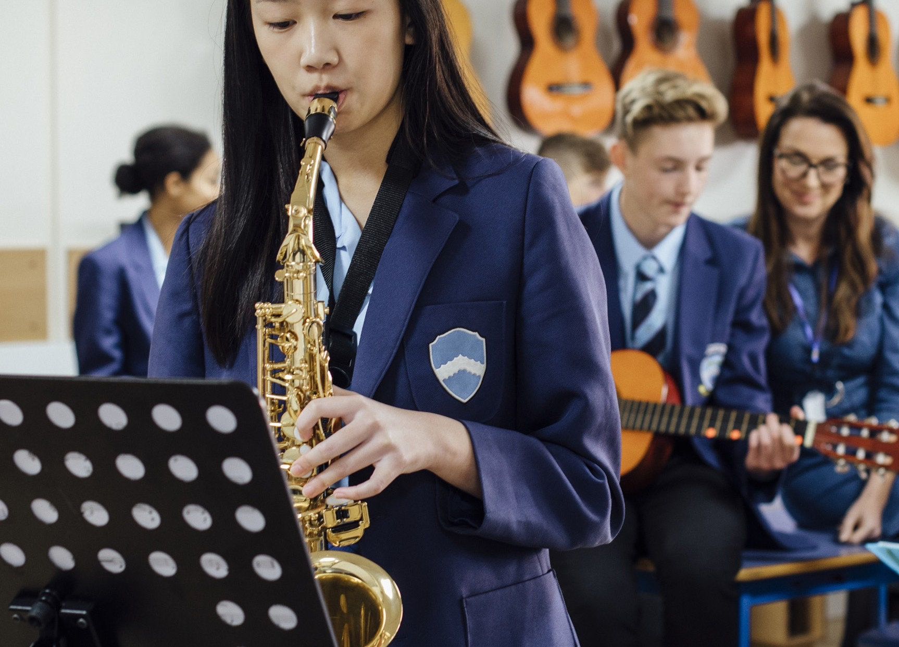
Skills section
Devote yourself to improving your skills in the things you love to do
Discover new passions and develop talents you didn’t know you had
Notes:
Through the Skills section, you will be encouraged to develop your practical and social skills in an area you can choose.
You can decide whether you will try to get better at something you already feel passionate about, or learn to do something new.
In the past, young people have done a huge range of different activities for their skills section, such as computer coding, driving and cooking.
Presenter: Please add in your own examples here.
Gaining new interests and talents is a huge amount of fun and lots of young people also feel a real sense of achievement from doing it.
​

Slide 13
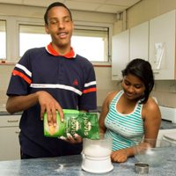
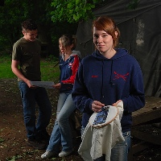
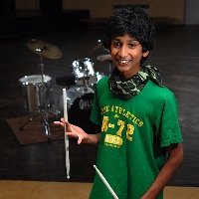
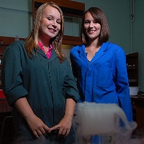
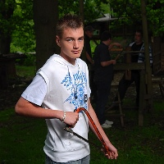
Skills categories
Creative arts
Performance arts
Science and technology
Care of animals
Music
Life skills
Learning and collecting
Media and communication
Natural world
Games
Who can assess me? e.g Key Adult, Art/Music/FTT teacher, family friend
How much do I need to do? 1hr per week minimum

Slide 14
Skills
Learning a new language
Playing an instrument
Care of animals/dog training
Baking
Physical sports

Slide 15
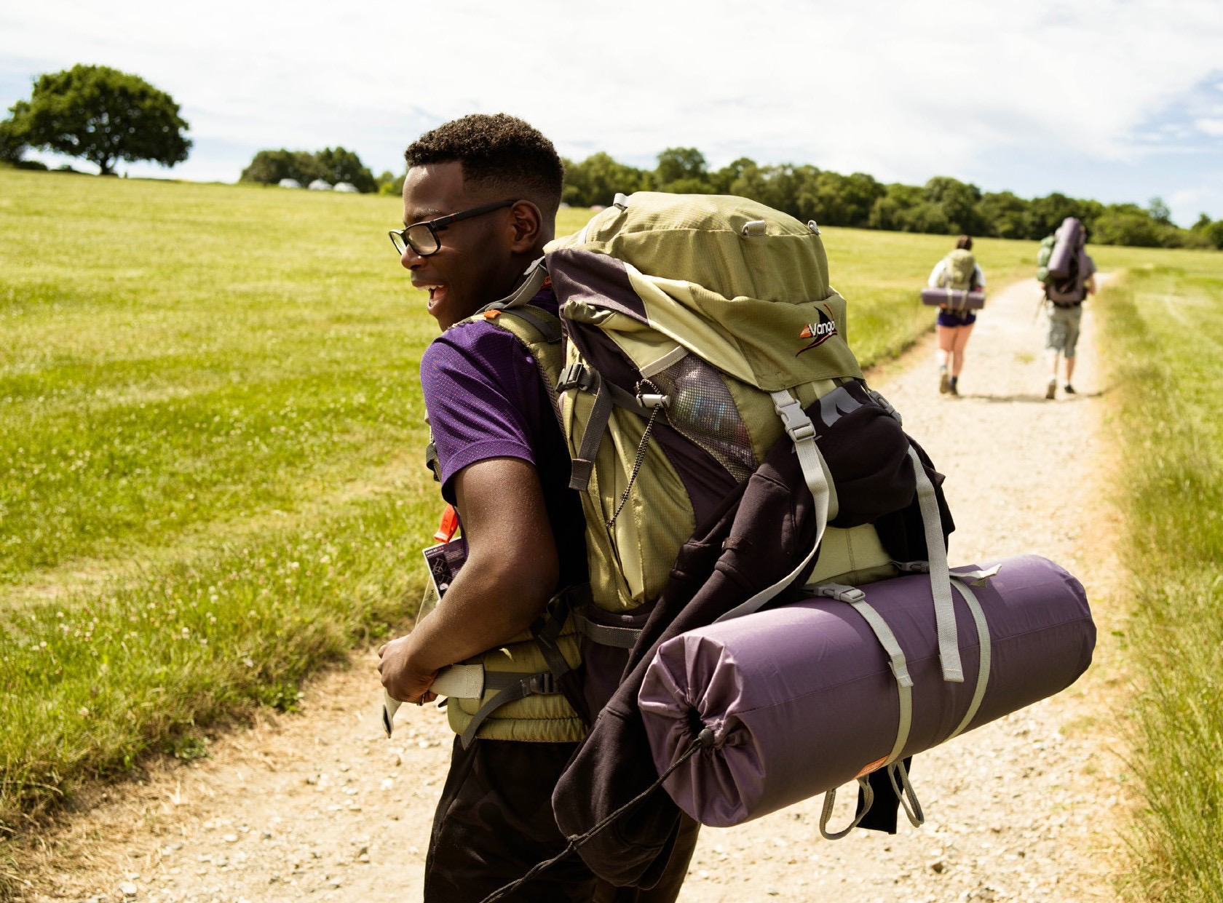
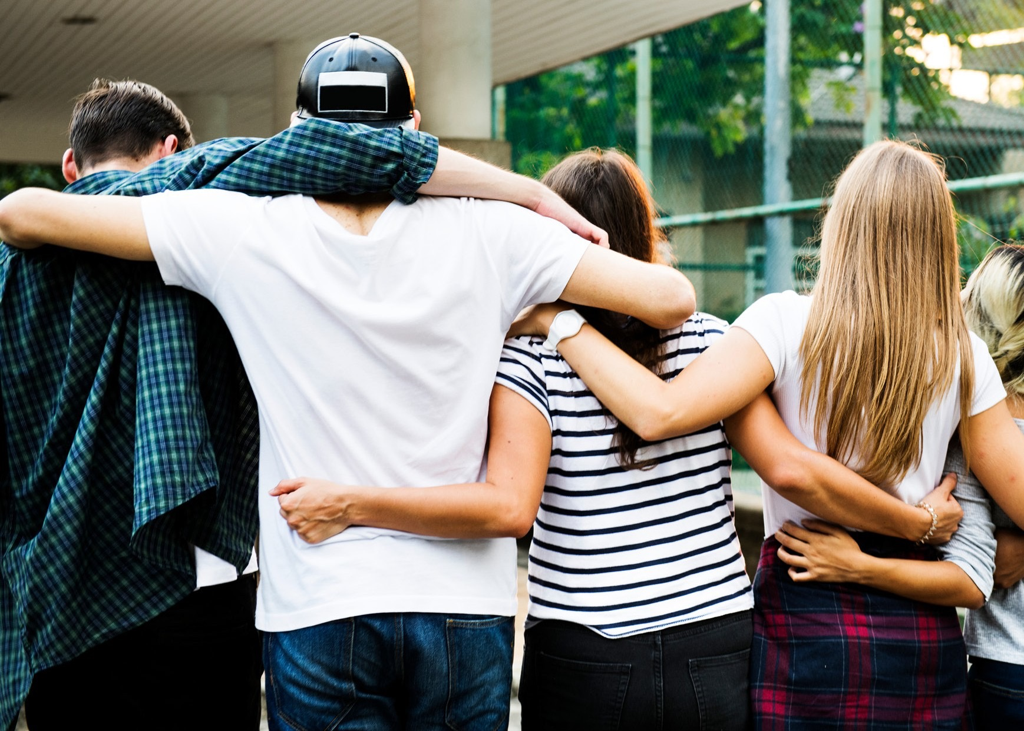
Expedition
Explore the great outdoors and spend a night away from home
Create memories that will last a lifetime
Notes:
The final section of your Bronze DofE Award is the Expedition.​
​As part of a small team, you’ll plan your aim, choose your location and do some training to make sure you’re prepared and know what you’re doing — then spend two days and one night away.​
​You can choose how you want to travel – it doesn’t have to be on foot. You could do it by bike, canoe, kayak, wheelchair, sailing boat or even on a horse.​
​Your Expedition will improve your resilience, communication, teamwork and leadership skills. ​
​Presenter: Please take care to place the same level of emphasis on each of the four sections. Whilst some young people may be attracted to the DofE because of the expedition, we know that some young people find this element daunting, so may need careful reassurance.
​

Slide 16

In order to qualify for the expedition, you must complete 2 of your 3 sections by
Monday 2nd of MARCH
These must be submitted and signed off on eDofE

Slide 17
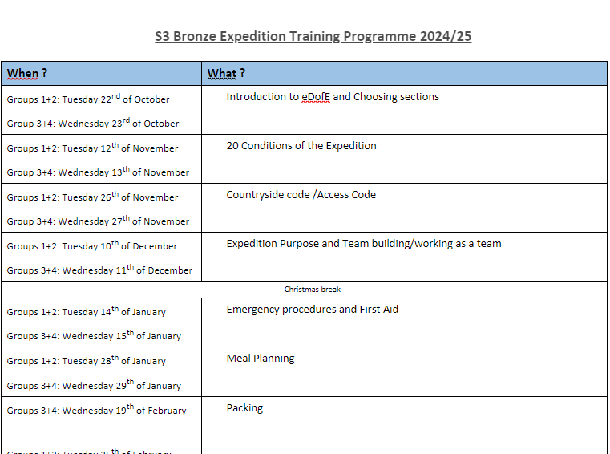

Training Programme - After school sessions
You will be able to sign up to either Tuesday or Wednesday training sessions.
Sign up for this will be on Teams.
You can find this programme on Teams and the noticeboard outside G40. Please add the dates to your calendar.

Slide 18
Training Sessions
You should attend every session and email your leader if you are unable to attend.
Attendance is monitored and if you miss more than 2 sessions without good reason, we will not allow you on expedition. This is because you won’t have completed the required training and so won’t be safe.
You should bring your iPad to every session.
Training lasts approx. 1hr
Tuesdays: Mr Lecomte + Ms Dunn
Wednesdays: Mr Murphy + Mrs Munro

Slide 19
Dates for your diary: 2025 Expeditions
Participants will have to sign up to one of each of the following dates.
EXPEDITION TRAINING – BROOMLEE
Group A: Monday 11th- Tuesday 12th of May
Group B: Wednesday 13th – Thursday 14th of May
QUALIFYING EXPEDITION – NORTH BERWICK
Group A: Wed 20th – Thur 21st of May
Group B: Wed 27th – Thur 28th of May
Group C: Tue 2nd – Wed 3rd June
You will sign up as part of an expedition group. In your group you will have to decide which dates you can all do. You may do Training A and Qualifier B, or any other combination of dates, but you must be able to do the same dates as the other members of your group

Slide 20
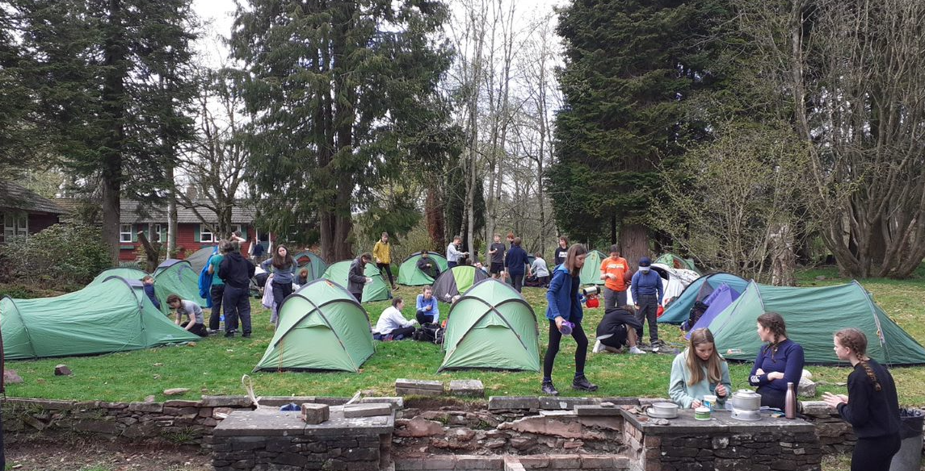
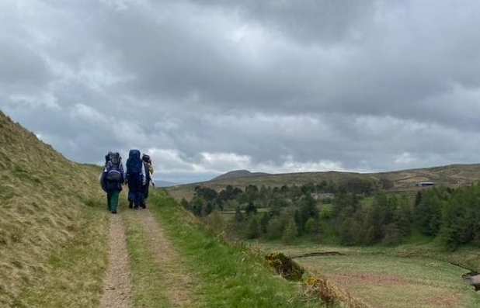
Expedition
Gain an appreciation of and respect for the
outdoor environment.
Develop and demonstrate enterprise and imagination.
Become more self-reliant.
Become more able to overcome challenges.
Recognise the needs and strengths of others.
Improve decision-making skills and the ability to accept consequences.

Slide 21
Timescales for qualifying expeditions
Level | Duration | Minimum hours of planned activity each day
Bronze | 2 days and 1 night | At least 6 hours during the daytime (at least 3 of which must be spent journeying)
You must be fully self-sufficient (you carry all of your food and equipment, but you can top up with water at the campsite)
You will be accompanied by an adult on your Training Expedition, but for the Qualifier you are supervised from a distance.

Slide 22
To secure your place…
Complete the Application form
Pay £30.50 deposit on ParentPay
by Friday 3rd of October
The remaining 2 instalments of £45 should be paid once expedition places are confirmed in March 2025. If you don’t finish your sections, you can’t go on Expedition!
If you have queries or issues with payment, please contact the school office in confidence, as financial help is available. Money worries should not prevent you from participating, the school can help.

Slide 23
Finances
The cost for the Bronze DofE programme is £120.50.
This price includes:
-DofE registration fee (£30.50)
-Kit hire (Tents/ Stoves/ Gas/ Rucksacks/ Mats/ Boots /Waterproofs/ Sleeping Bags /1st aid kits)
-Campsite fees
-Coach hire
-Use of Qualified instructors/Assessors

Slide 24
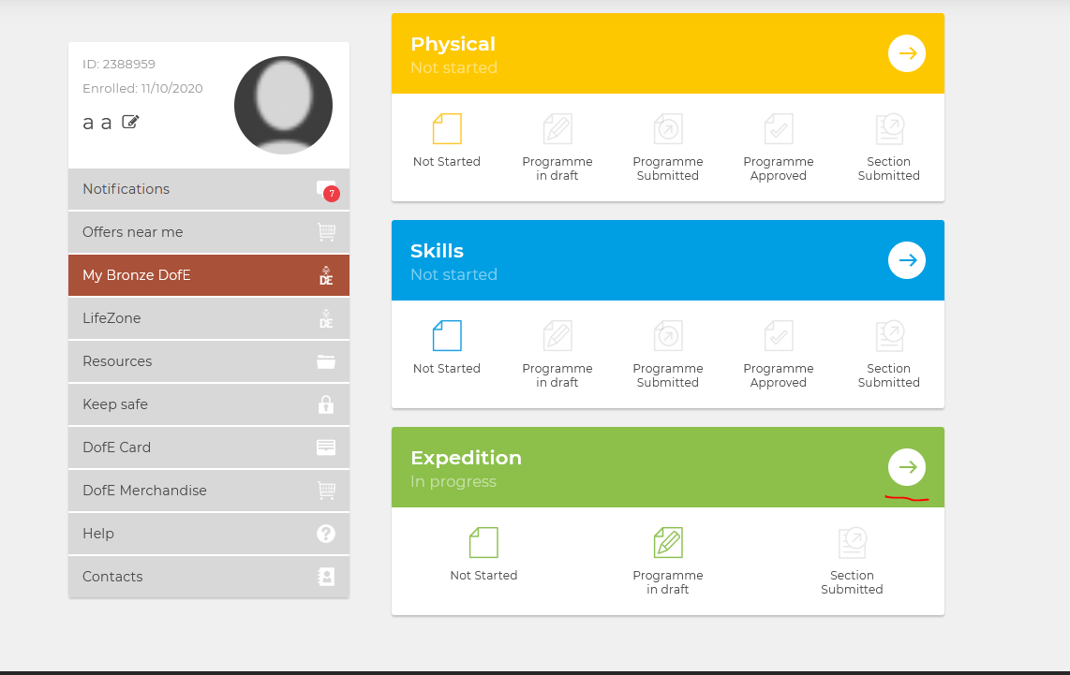
edofe.org
Once you have submitted your form and deposit, you will receive an email with your login details to your eDofE account
Please take a note of your Username and Password
eDofE is where you should log and submit all of your evidence for all of your sections. Evidence can be text or photo.
You do not need to submit evidence for every single week of your activity, but it should give a broad idea of what you did and achieved.
There is also an app however it is not (currently) supported on our school iPads

Slide 25


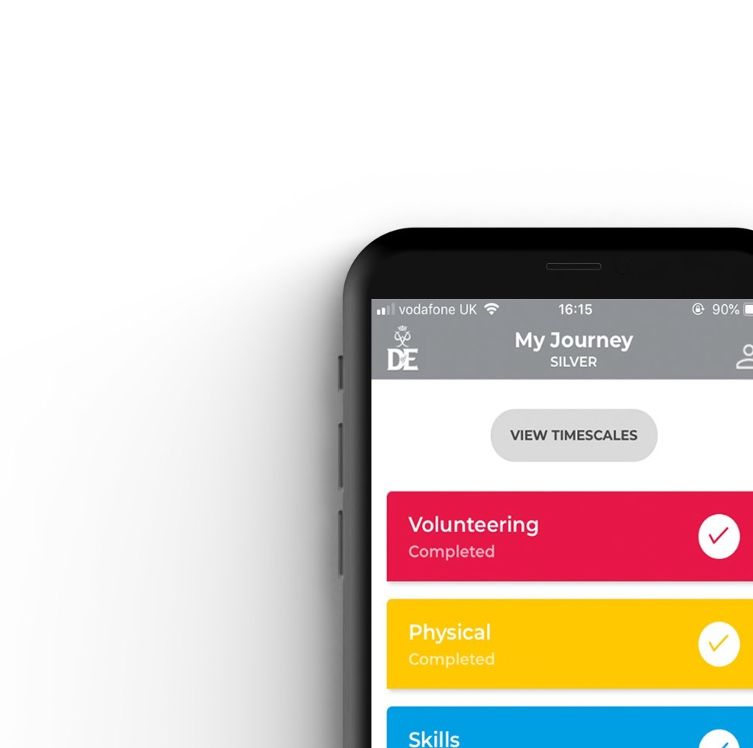


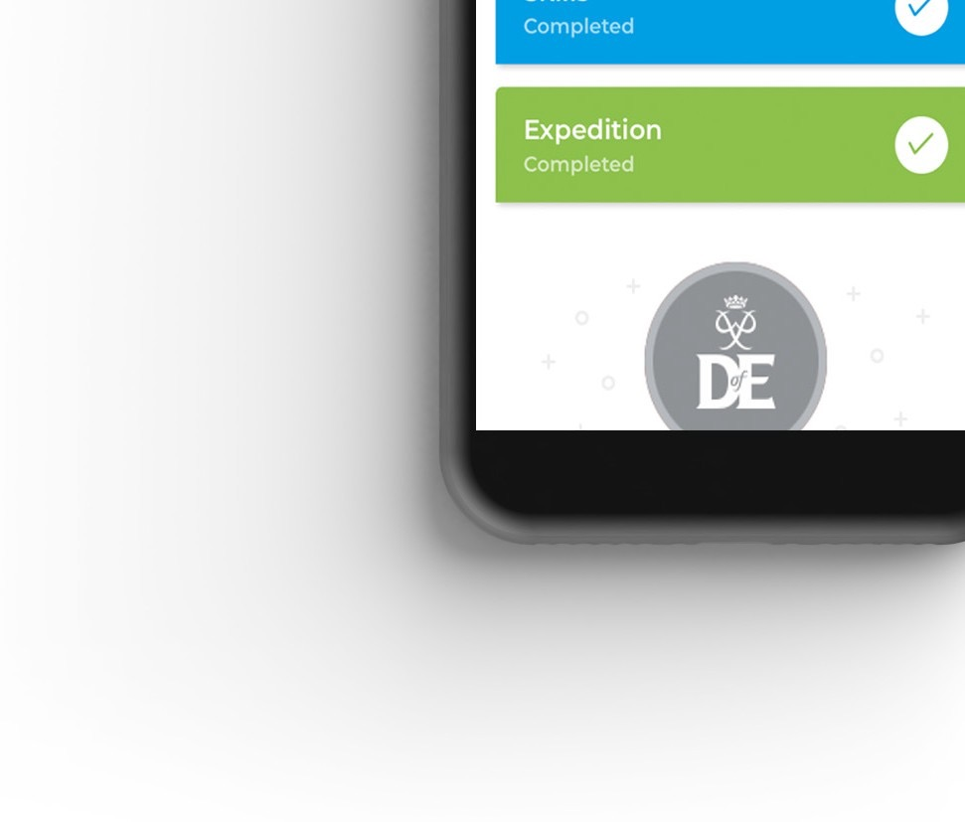
Your Welcome Pack and eDofE
Notes:
Once you have signed up to do your DofE, you will receive a Welcome Pack in the post which contains lots of useful information and advice. ​
​You will also get your own eDofE account so that you can plan your activities online using the free DofE app.​
​You will also receive a DofE Card which will give you and your family money off in several shops selling the sorts of equipment you may need.​

Slide 26
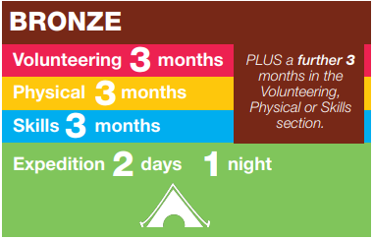
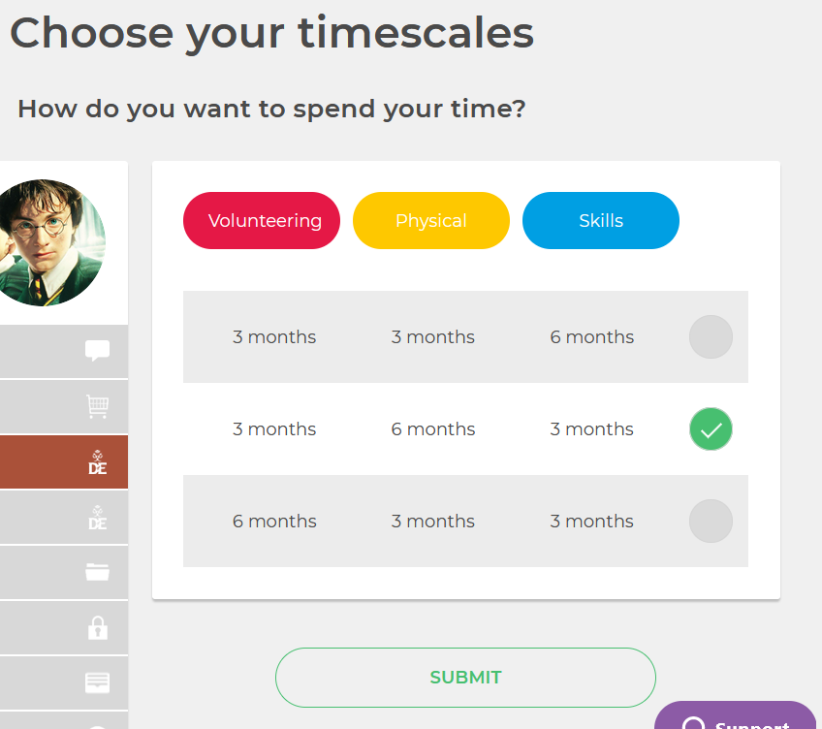

Slide 27

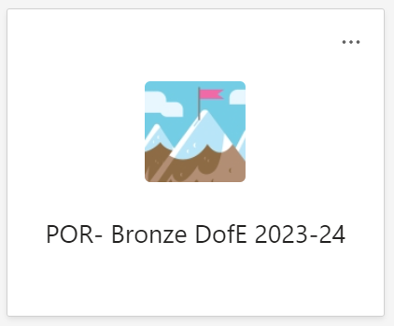
Communication
All communication for DofE is done through the POR- Bronze DofE 2025-26 Team.
You must switch on notifications and check it regularly.
In the files section you will find useful documents such as lists of ideas for the sections and Expedition Training materials.
There is a channel with links to volunteering opportunities too.
You can post on the Team to ask questions or email any of the DofE Leaders.
Once your application has been processed, you will be added to the Team.
POR- Bronze DofE 2024-25

Slide 28

Questions

Slide 29
